Slide 1
Matlab gösterimi:
J=0.01; b=0.1;K=0.01;R=1;L=0.5;
The transfer function (9) can be entered in MATLAB in a number of different ways.
1. As Ga(s) can be expressed as Gv(s) 1/s , we can enter these two transfer functions separately and combine them in series:
aux = tf(K,conv([L R],[J b]))
Gv = feedback(aux,K);
Ga = tf(1,[1 0])*Gv;
Here, we made use of the function feedback to create a feedback connection of two transfer functions and the multiplication operator *, which is overloaded by the LTI class of the Control System Toolbox such that is computes the product of two transfer functions.
2. Instead of using convolution, the first of the above three commands can be replaced by the product of two transfer functions:
aux = tf(K,[L R])*tf(1,[J b]);
3. Another possibility (perhaps the most convenient one) is to define the transfer function in a symbolic way. First introduce a system representing the Laplace operator s (differentiator) and then enter the transfer function as an algebraic expression:
s = tf([1 0],1);
Gv = K/((L*s + R)*(J*s + b) + Kˆ2);
Ga = Gv/s;

Slide 2
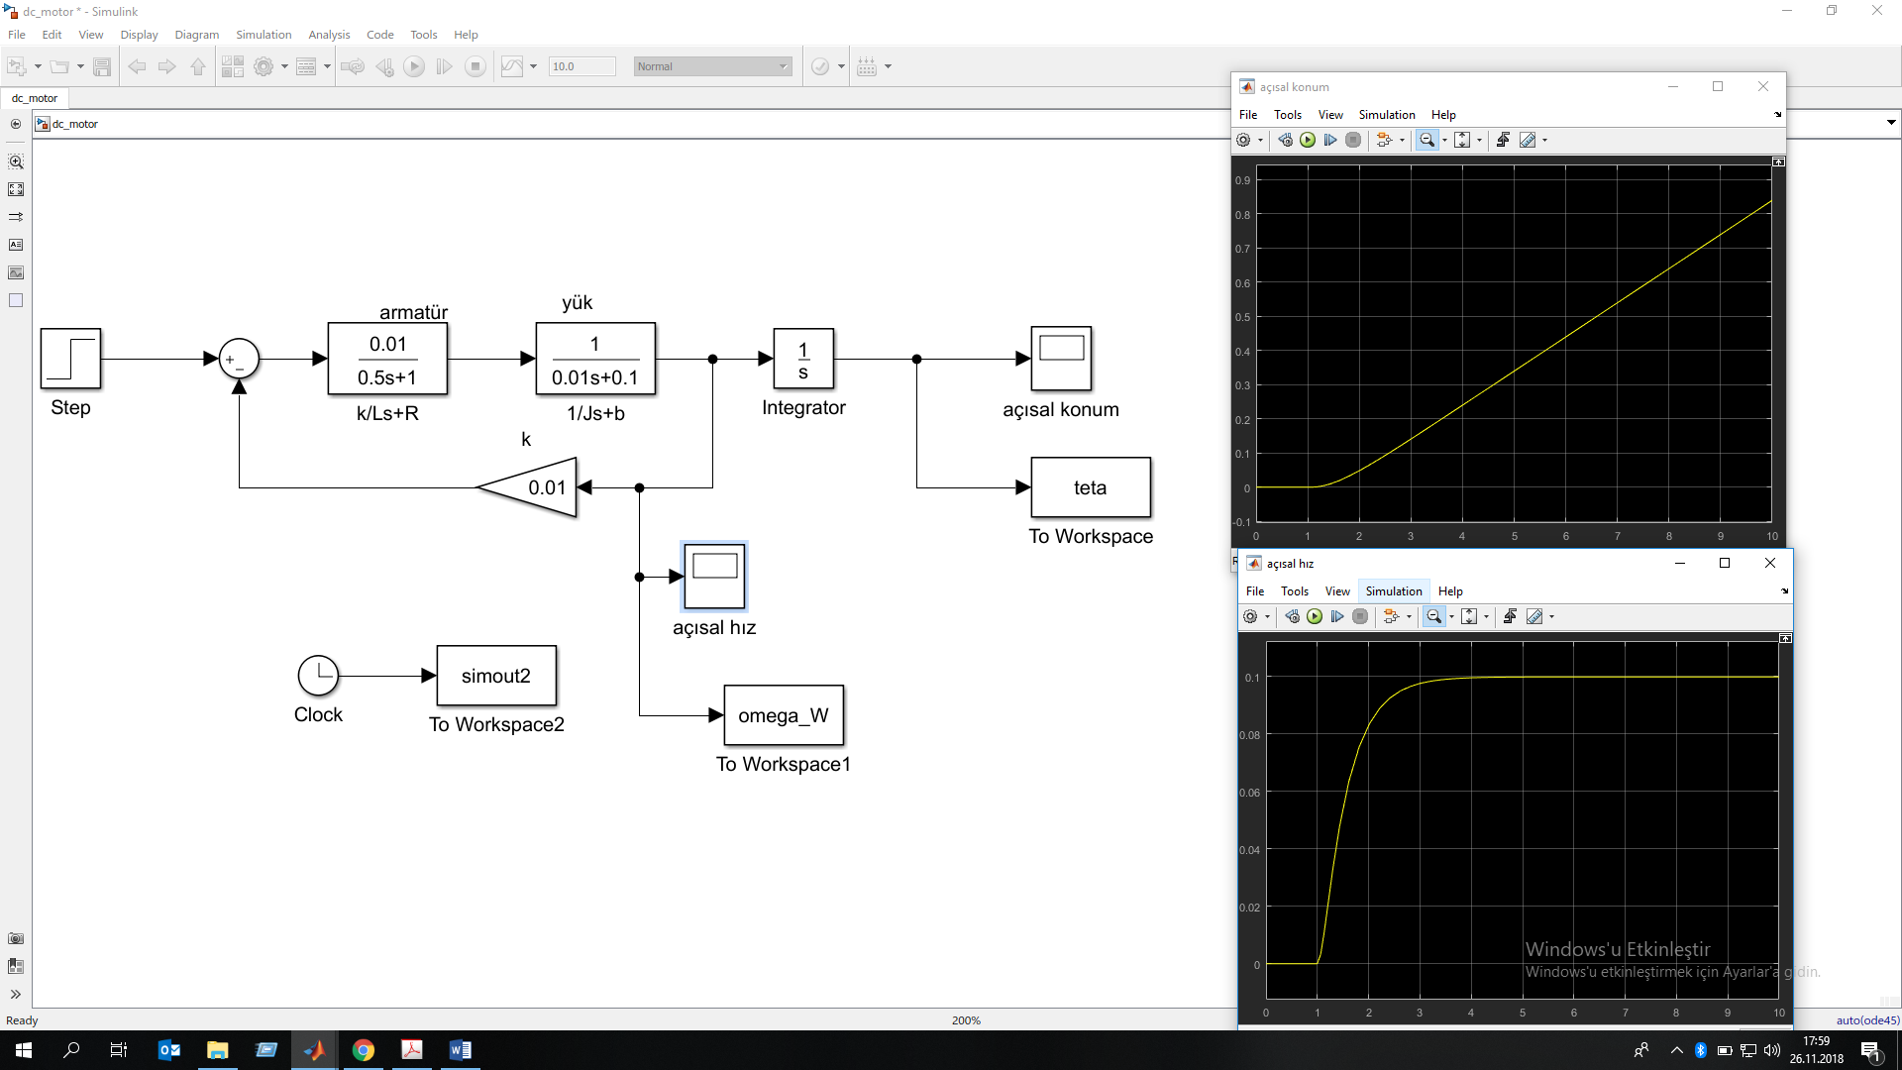
Transfer fcn
Transfer fcn
scope
gain

